Slide 1

Data Analytics
Premier League Player Statistics

Slide 2
WHO ARE WE?

Slide 3



Team Members
Lorenzo Munisami
Thamsanqa Miya
Michael Lamula
217037162
217006534
217032601

Slide 4



Team Members
Lwazi Ndabula
Shaylen Ukbush
Ntobeko Mvubu
218050633
218053178
218031800

Slide 5


ROLES

Slide 6

AGILE SCRUM METHODOLOGY

Slide 7
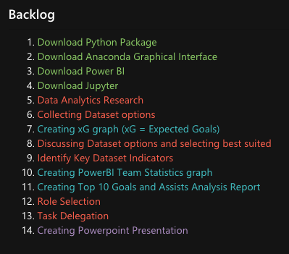
BACKLOG

Slide 8
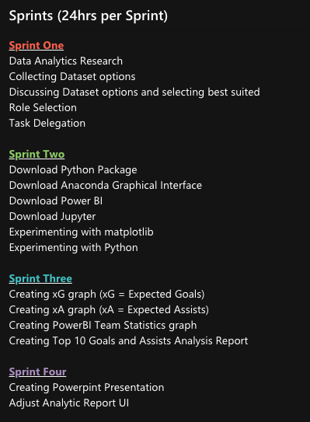
SPRINT ONE

Slide 9
SPRINT TWO

Slide 10
SPRINT THREE

Slide 11
SPRINT FOUR

Slide 12
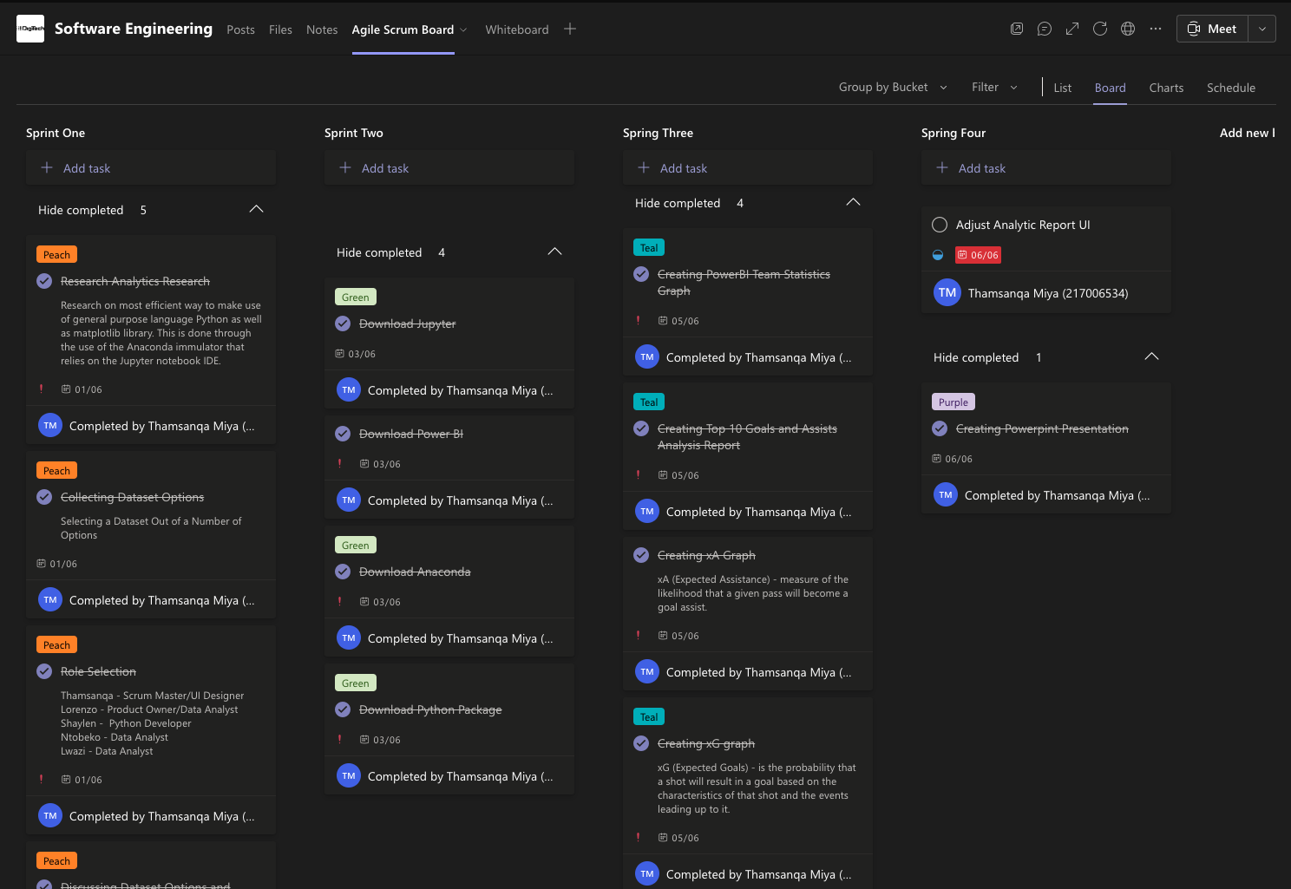
TASK MANAGER OVERVIEW

Slide 13

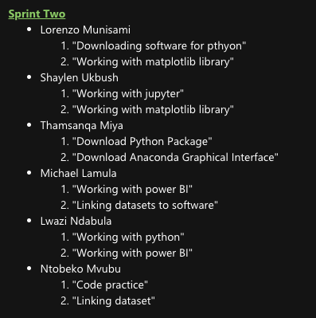
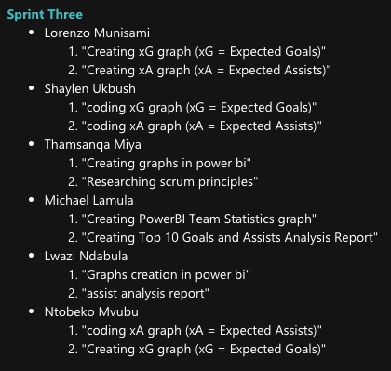

DAILY STANDUPS
01/06/2020
03/06/2020
05/06/2020
06/06/2020

Slide 14
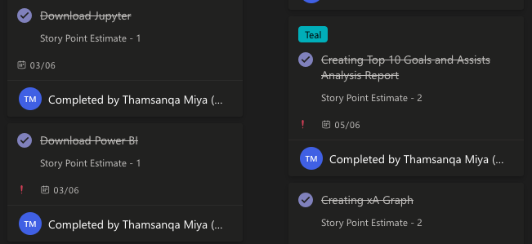
STORY POINT ESTIMATE
Story Points – shows how much effort that was used and is needed to change a Backlog Item from 'In Progress' to 'Complete'. Story Points represent an allocation of time for each Backlog Item.

Slide 15

PREMIER LEAGUE STATS 2021/22

Slide 16
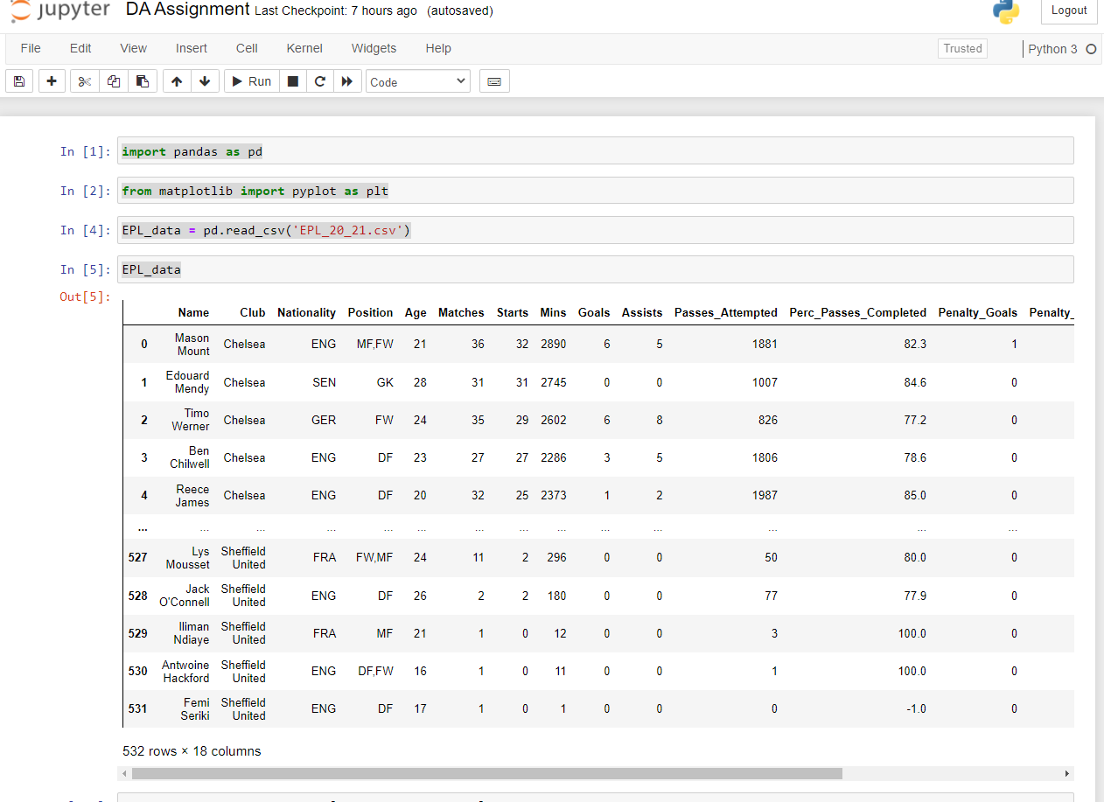

Dataset from Kaggle

Slide 17
DATA DEFINITIONS
Each of these statistical metrics are calculated using a set of related variables:
xG (Expected Goals) - is the probability that a shot will result in a goal based on the characteristics of that shot and the events leading up to it.
xA (Expected Assists) - measure of the likelihood that a given pass will become a goal assist.

Slide 18

Python

Slide 19
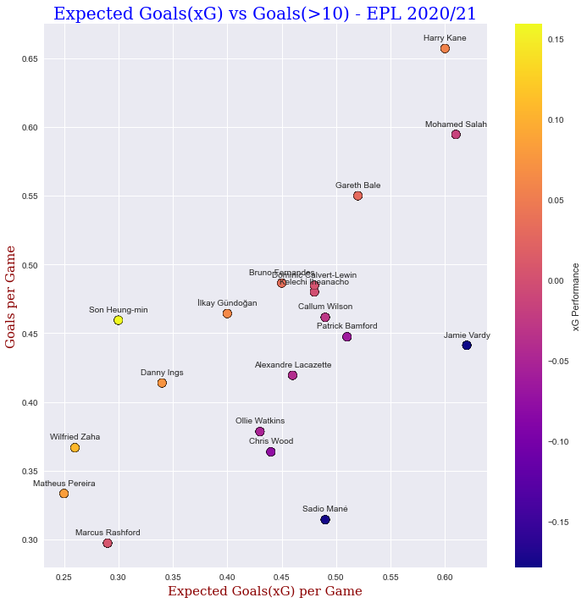
xG vs Goals

Slide 20
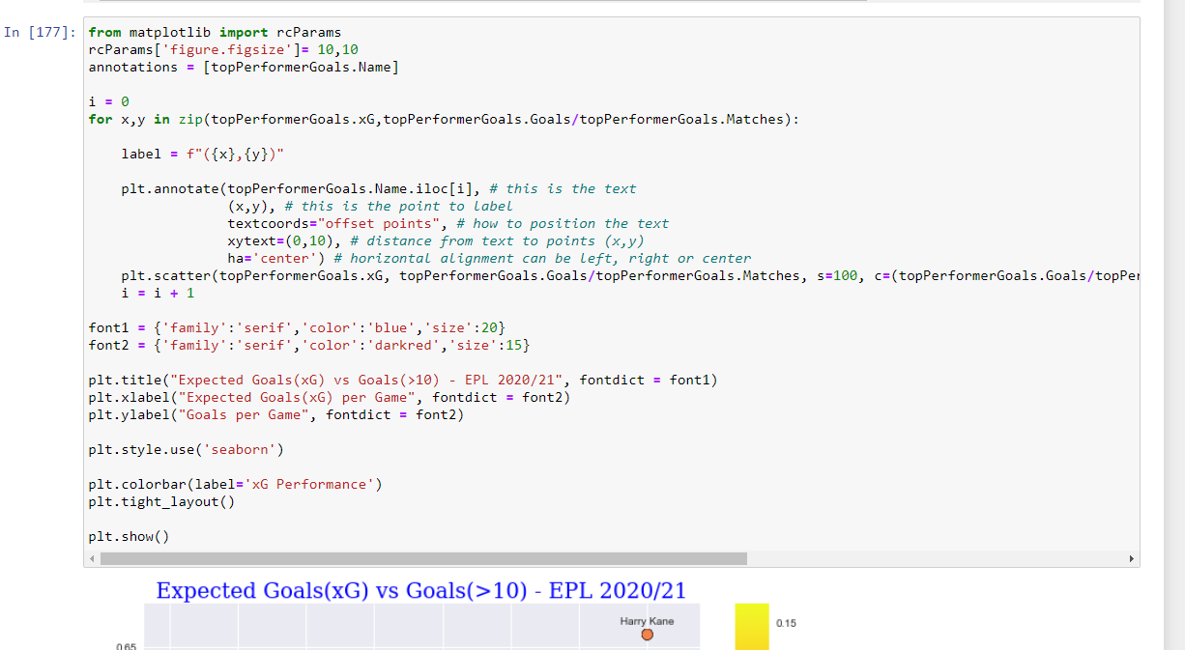
xG vs Goals

Slide 21
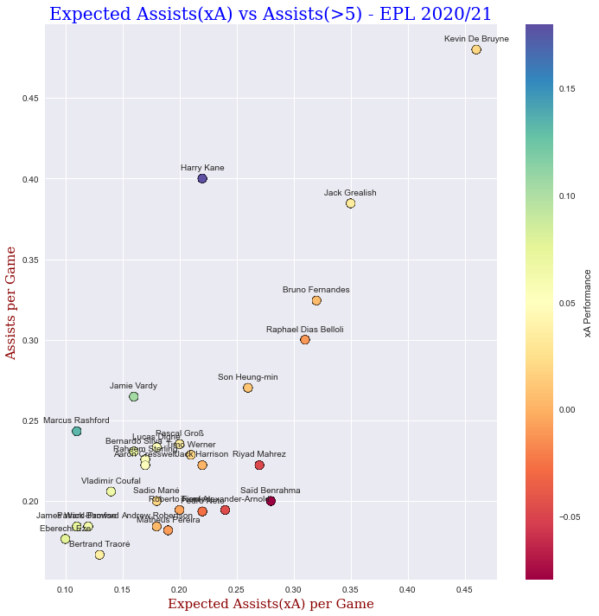
xA vs Assists

Slide 22
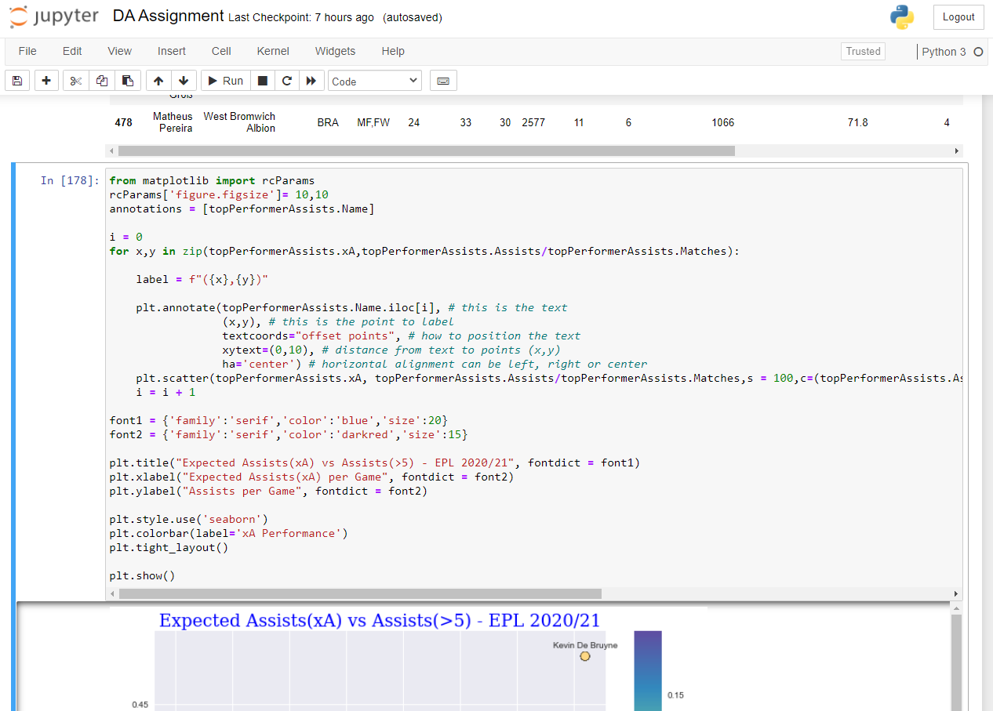
xA vs Assists

Slide 23

Power Bi

Slide 24
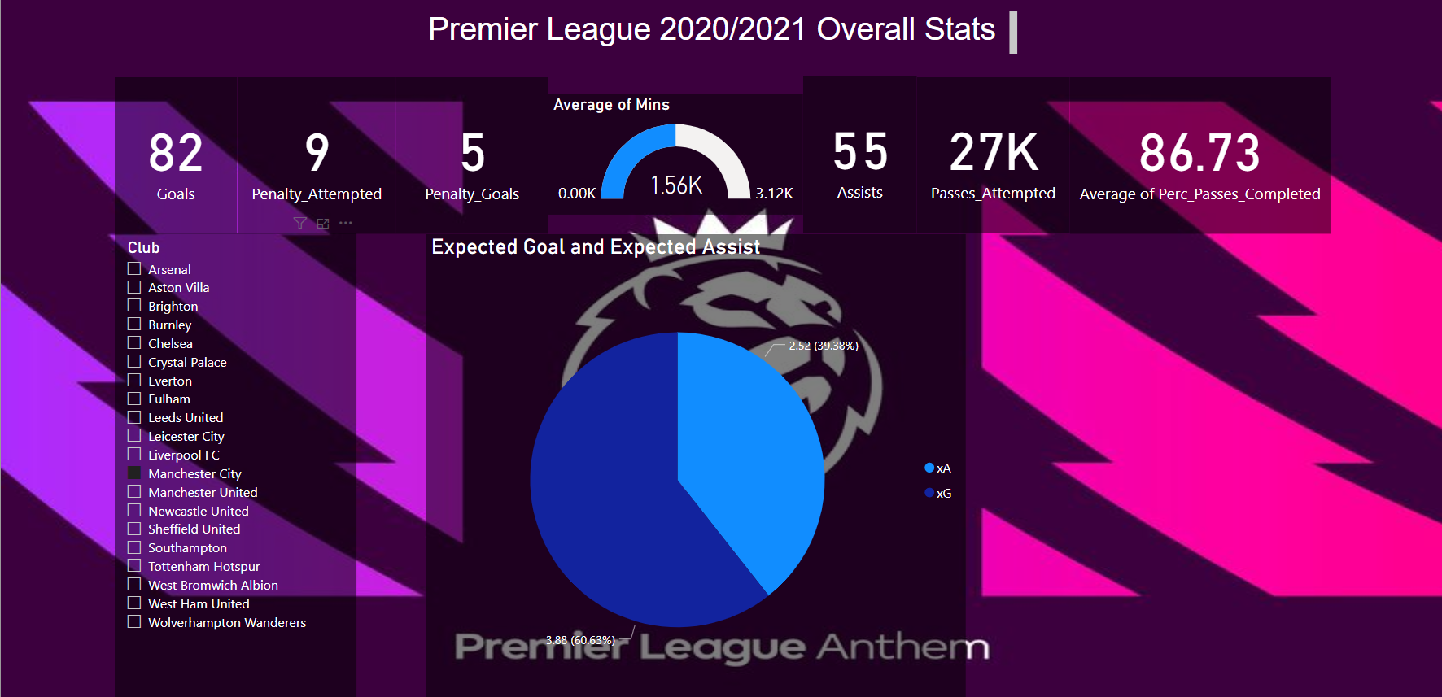

Slide 25
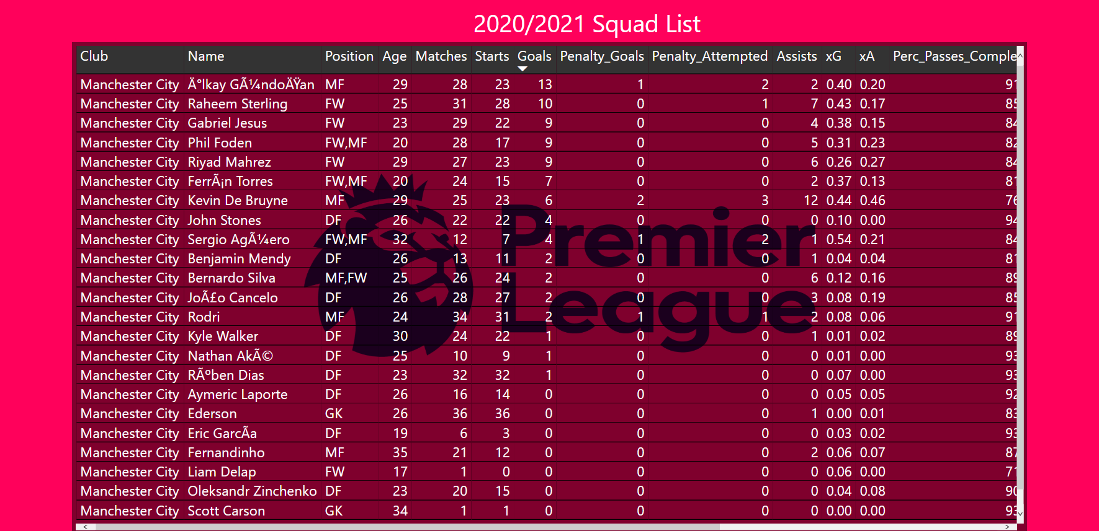

Slide 26
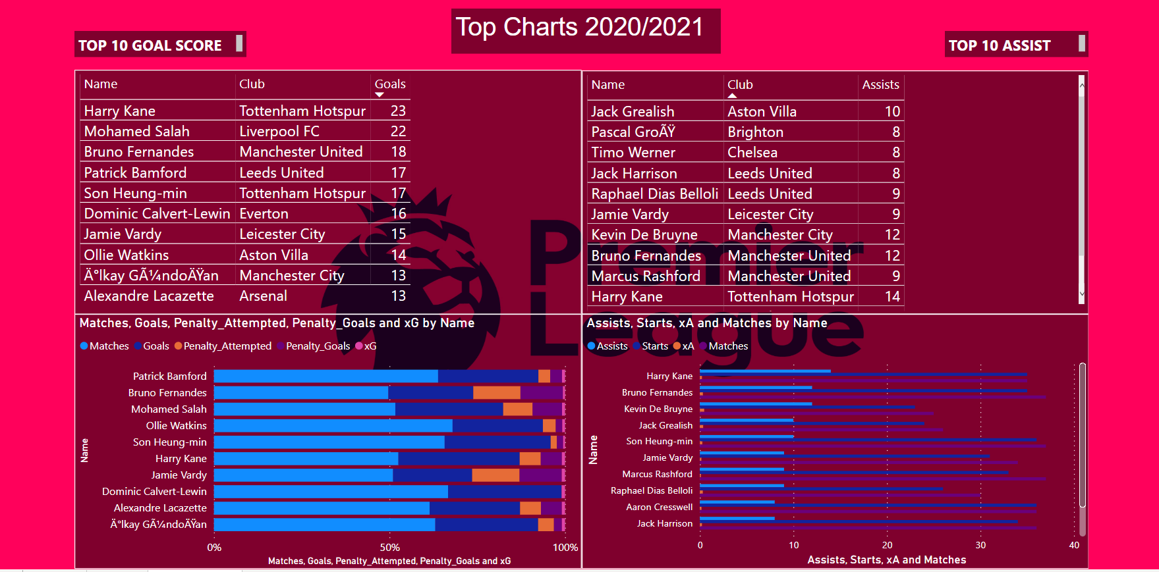

Slide 27
Data Analytics
Premier League Player Statistics

